Slide 1
Humans Performance in Hockey
Qi Dong
Special Thanks to Professor Mendonca, Mr. Zhang, Mr. Segall

Slide 2
Research Objective
Explore how the change in team composition will affect team performance in total
In this semester, we focus mainly on the performance in one possession

Slide 3
Three Subsets of Data
Event Data
Line Change Data
Possession Data

Slide 4
Event Data
What is happening on ice
Ex. Shot for, Shot Against, Takeaway, and Giveaway
We will use event data to analyze performance

Slide 5
Line Change Data
The change in members composition
Time on ice
We didn’t focus too much on Line Change Data in this semester

Slide 6
Possession Data
Who has the puck
Our definition for possession in this research : whose stick touches the puck

Slide 7
Phase One Recording Possession
Game One : RPI v.s. Colgate (Feb 1)
Game Two : RPI v.s. Quinnipiac (Feb 16)
Game Three : RPI v.s. Harvard (Mar 1)
Game Four : RPI v.s. Dartmouth (Mar 2)
Software Used: XOS

Slide 8
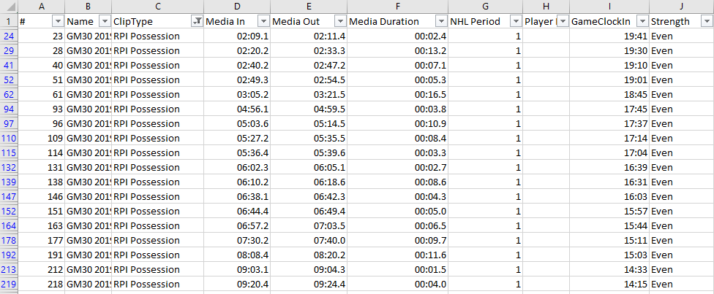
Figure 1 Possession Data

Slide 9
Phase 2 Recording Latency
Definition for latency in this research : the time it takes to record a data
Useful events : Faceoff, Shot for, Shot against, and Possession
We need possession to analyze performance
Easy to record when it actually happens
Steps for measuring latency
Obtain Time from event data
Add buffer time
Record when it actually happens
Calculate latency
Take the average

Slide 10
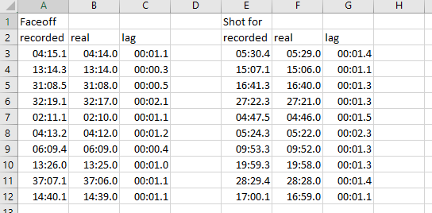
Figure 2 Measuring Latency
Notes:
From Colgate game. Ten samples for each event.
This is an example of how we measure latency. Recorded is the time from the original file plus the buffer time. Real is the time when the event actually happens. Recorded minus real gives us the latency.

Slide 11
Figure 3 Latency Data
Notes:
We have latency data for 4 events. Faceoff and Shot for have 40 samples of latency. 10 for each game.
Shot against and possession only have 10 samples from Quinnipiac

Slide 12
Phase 3 Analyzing Latency
Simple t test
Null Hypothesis : the means of lag time for two different events are the same Two Events : Faceoff, Shot for (have a large number of samples)
Results : reject null hypothesis
The latencies for different events are different. We can only adjust time using mean latencies of each single event

Slide 13
2. Multiple t test
Null Hypothesis : the means of lag time for the same events are the same across all games
Result : fail to reject the null hypothesis

Slide 14
3. Variance Test
Null Hypothesis : the variances of lag time for two different events are the same
Result : reject the null hypothesis

Slide 15
4. Chi-square Test
Null Hypothesis : There is no relationship between the events that Noah has recorded and the events that I have recorded
Results : reject the null hypothesis

Slide 16
Period 4 Creating Study Data
Step one : Cleaning Event and Possession Data
Step two : Read in the 12 files
Step Three : Combine the 12 tables
Step Four : Correcting the table
Step Five : Add a new attribute named PossID
Step Six : Add a new attribute named EventSeq

Slide 17
Step One : Cleaning Event and Possession Data
Possession, Faceoff, Shot for and Shot Against add buffer time and latencies
Other events only add buffer time
Create 12 separate files with three attributes (Time, Event, Possession)

Slide 18
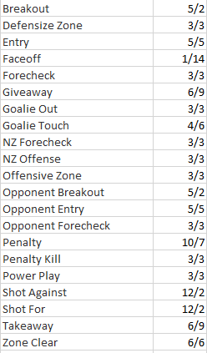
Figure 4 Buffer Time for Each Event
Notes:
The number before the slash is the buffer time. After the slash is the lag time

Slide 19
Step two : Read in the 12 files
Sort each table by time
Fill in the empty cells in Possession attributes by using the possession of the event in front
Add two new attributes : Game, Period
Repeat the steps for the remaining periods

Slide 20
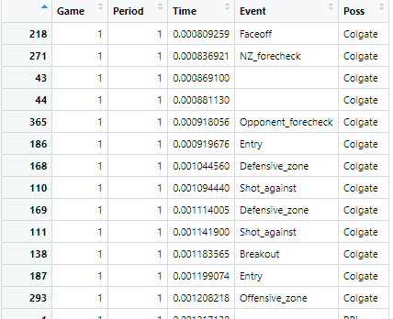
Figure 5 The Table after Step Two

Slide 21
Step Three : Combine the 12 tables
Add a new attribute (EventPoss)
Rpi event : Shot for, Takeaway
Oppo event : Shot against, Giveaway

Slide 22
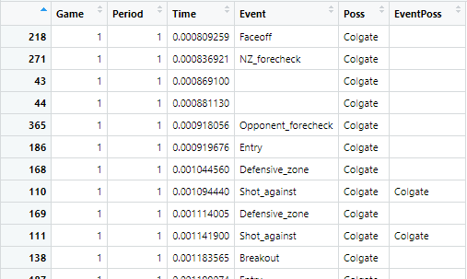
Figure 6 The Table after Step Three

Slide 23
Step Four : Correcting the table
If event possession is different from possession
If event possession is the same as the possession of the event before -> switch with the event before
If event possession is the same as the possession of the event after -> switch with the event after
Else -> delete

Slide 24
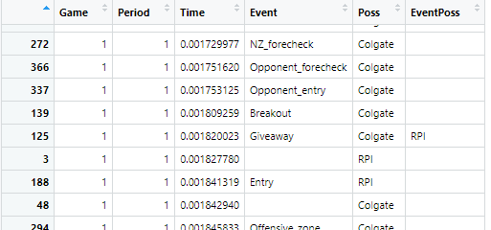
Figure 7 An Example

Slide 25
Step Five : Add a new attribute named PossID
Two counters : counterrpi and counteroppo
When possession changes -> add one
When period changes -> reset to one

Slide 26
Step Six : Add a new attribute named EventSeq
When the possession does not change -> add one
When the possession changes -> reset to one

Slide 27
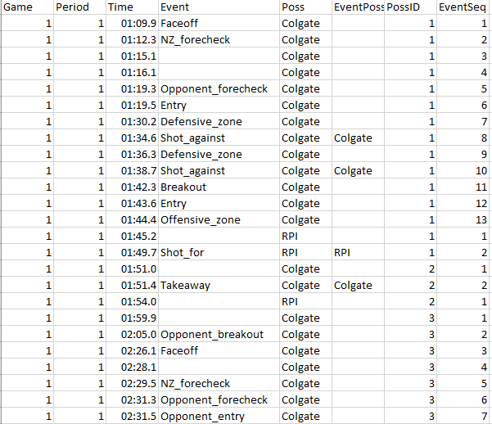
Figure 8 The Study Data

Slide 28
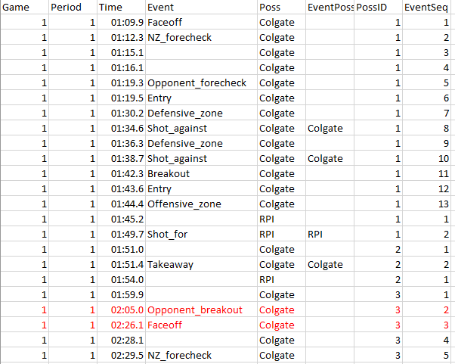
Figure 9 Remaining Problems
Notes:
We don’t know when the game stops by only looking at the the study data.

Slide 29
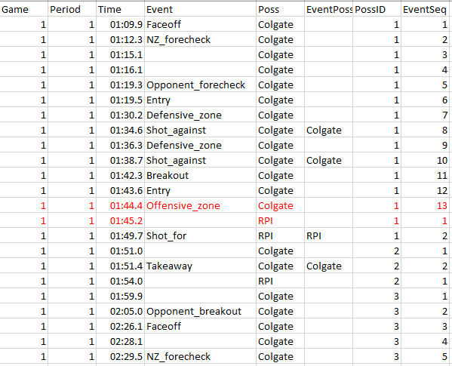
Figure 10 Remaining Problems
Notes:
Sometimes we don’t know what happens when a possession changes

Slide 30
Questions ?

